Slide 1
ARTIFICIAL INTELLIGENCE
Prof. Dr. Mohamed K. Hussein
Suez Canal University

Slide 2
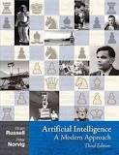
Textbook
Stuart Russell and Peter Norwich, Artificial Intelligence: A Modern Approach, 2020.

Slide 3
Course Objectives
Introducing Artificial Intelligence.
Definition and Domains
A brief look at the history of AI.
Discussing the different faculties involved with intelligent behavior,
The different components that define intelligence.
Examining the different ways of approaching AI
Look at some example systems that have been constructed,
That are popularly known which use AI
On taking this lesson you should become familiar with Underlying ideas, such as :
search, knowledge representation, expert systems and learning.

Slide 4
Course overview
Topic | Week
AI Definition, history and applications. | 1
Problem Solving by search | 2 - 3
Advanced Search methods | 4 - 5
Knowledge base representation & reasoning | 6 -7
Decision tree | 8 - 9
Bayes classifier | 10 -11
Reinforcement learning | 12 -14

Slide 5
Introduction
These are four main components of today’s lecture.
Definition of AI,
Example systems,
The brief history
Examples of AI problems

Slide 6
What is Artificial Intelligence?
AI is concerned with the design of intelligence.
AI is actually concerned with design of intelligence in artificial artifacts and artificial devices.
Intelligence may be defined as:
The capacity to acquire and apply knowledge.
The faculty of thought and reason.

Slide 7
What is AI? Intelligence as something that characterizes humans: Think … Perceive …. Act
Systems that think like humans (Cognitive Science) | Systems that think rationally (Laws of thought)
"The exciting new effort to make computers think . . . machines with minds, in the full and literal sense." (Haugeland, 1985) "[The automation of activities that we associate with human thinking, activities such as decision-making, problem solving, learning . . ." (Bellman, 1978) | "The study of mental faculties through the use of computational models.“ (Chamiak and McDermott, 1985) "The study of the computations that make it possible to perceive, reason, and act.“ (Winston, 1992)
Systems that act like humans | Systems that act rationally
"The art of creating machines that perform functions that require intelligence when performed by people." (Kurzweil, 1990) "The study of how to make computers do things at which, at the moment, people are better." (Rich and Knight, 1991) | "Computational Intelligence is the study of the design of intelligent agents." (Poole et al., 1998) "AI . . .is concerned with intelligent behavior in artifacts." (Nilsson, 1998)

Slide 8
Rational agents = Intelligent agents
An agent is an entity that perceives and acts
This course is about designing rational agents
Abstractly, an agent is a function from percept histories to actions:
f : P∗ → A

Slide 9
What is Artificial Intelligence ? More definitions
Artificial intelligence is the study of systems that act in a way that to any observer would appear to be intelligent.
Artificial Intelligence involves using methods based on the intelligent behavior of humans and other animals to solve complex problems.
AI is concerned with real-world problems (difficult tasks), which require complex and sophisticated reasoning processes and knowledge.

Slide 10
Artificial intelligence
The theory and development of computer systems able to perform tasks normally requiring human intelligence such as:
Speech recognition
Language translation
Decision making

Slide 11
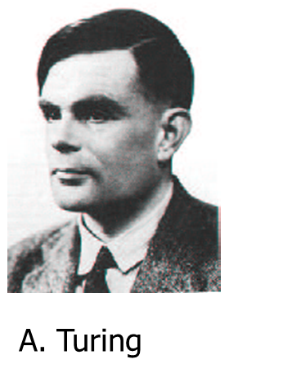
What is Artificial Intelligence ?
Operational Definition of AI (Turing Test):
In 1950 Turing proposed an operational definition of intelligence by using a Test composed of :
An interrogator (a person who will ask questions)
a computer (intelligent machine !!)
A person who will answer to questions
A curtain (separator)

Slide 12
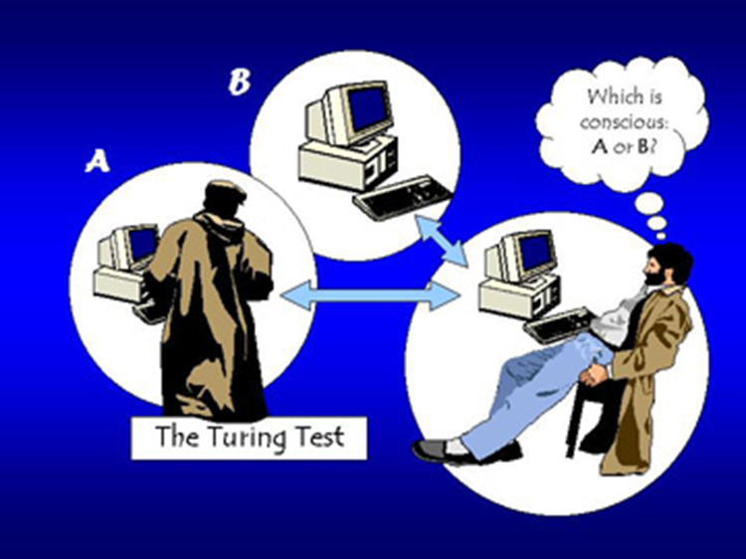
What is Artificial Intelligence ?
The computer passes the “test of intelligence” if a human, after posing some written questions, cannot tell whether the responses were from a person or not.

Slide 13
When can we say a computer is intelligent?
The computer would need to possess the following capabilities:
Natural language processing: to enable it to communicate successfully in English.
Knowledge representation: to store what it knows or hears.
Automated reasoning: to use the stored information to answer questions and to draw new conclusions;
Machine learning: to adapt to new circumstances and to detect and extrapolate patterns.
Computer vision: To perceive objects.
Robotics to manipulate objects and move.

Slide 14
Typical AI Problems
Mundane tasks:
Route Planning
Object recognition
Natural language communication
Navigating round obstacles on the street
Game playing
Expert tasks:
Medical diagnosis
Mathematical problem solving

Slide 15
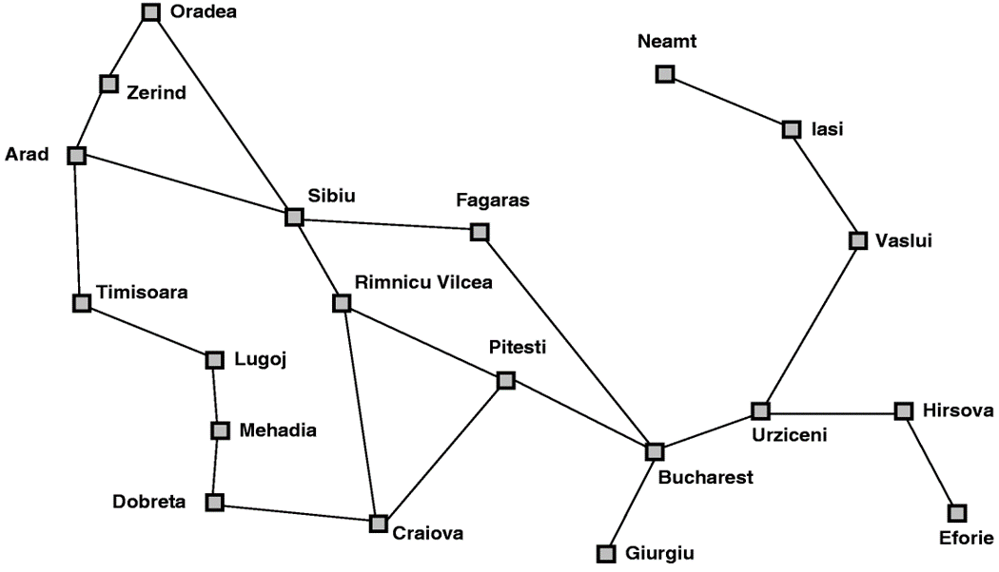
Navigation and route planning

Slide 16
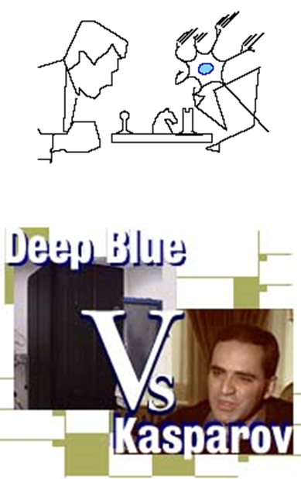
Game Playing
TDGammon, the world champion backgammon player, built by Gerry Tesauro of IBM research
Deep Blue chess program beat world champion Gary Kasparov
Chinook checkers program

Slide 17
Natural Language Understanding
AI Translators – spoken to and prints what one wants in foreign languages.
Natural language understanding (spell checkers, grammar checkers)

Slide 18
Expert Systems
In geology
Prospector expert system carries evaluation of mineral potential of geological site or region
Diagnostic Systems
Pathfinder, a medical diagnosis system (suggests tests and makes diagnosis)
MYCIN system for diagnosing bacterial infections of the blood and suggesting treatments
Financial Decision Making
Credit card providers, banks, mortgage companies use AI systems to detect fraud and expedite financial transactions.
Configuring Hardware and Software
AI systems configure custom computer, communications, and manufacturing systems, guaranteeing the purchaser maximum efficiency and minimum setup time.

Slide 19
Robotics
Robotics becoming increasing important in various areas like: games, to handle hazardous conditions and to do tedious jobs among other things. For examples:
Automated cars, ping pong player
Mining, construction, agriculture
Garbage collection

Slide 20
AI History
Year | History
1943 | McCulloch & Pitts: Boolean circuit model of brain
1950 | Turing’s “Computing Machinery and Intelligence”
1950s | Early AI programs, including Samuel’s checkers program,
1960s | Early development of knowledge-based systems
1980s | Expert systems
1990s | Neural networks
Now | Agents, agents, everywhere ...

Slide 21
A Quick Introductory Overview
The main AI topics we’ll cover in this introductory course:
Problem solving by searching
(Uninformed search, heuristic search …)
Knowledge-based systems
(expert systems …)
Machine learning
(neural networks, …)
Artificial Life <Modern AI>
(cellular automata, GAs …)

Slide 22
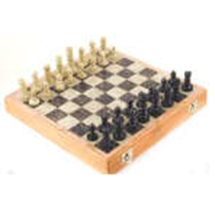
Problem Solving by Searching
Why search ?
Early works of AI was mainly towards
proving theorems
solving puzzles
playing games
All AI is search!
Not totally true (obviously) but more true than you might think.
Finding a good/best solution to a problem amongst many possible solutions.

Slide 23
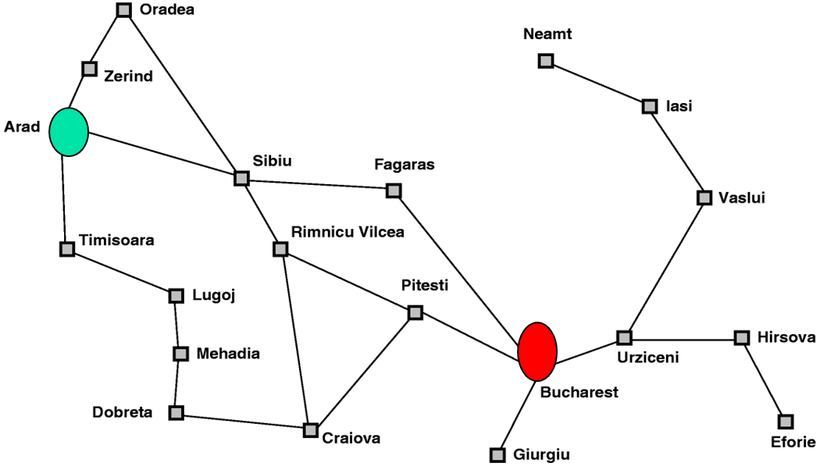
Classic AI search problems Map searching (navigation)

Slide 24
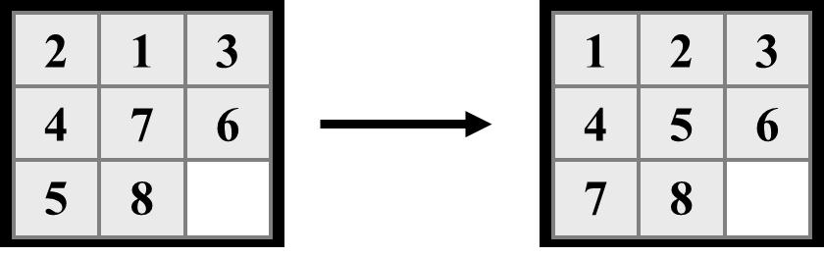
Classic AI search problems 8-Puzzle

Slide 25
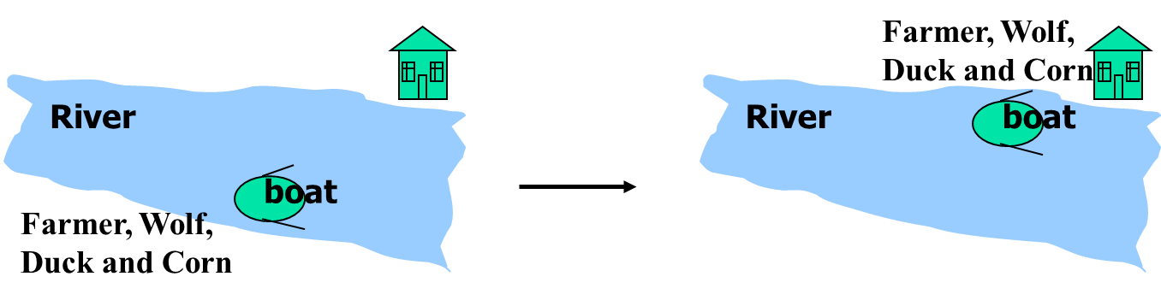
Classic AI search problems The River Problem
A farmer wishes to carry a wolf, a duck and corn across a river, from the south to the north shore.
The farmer is the owner of a small rowing boat.
Unfortunately the boat is only large enough to carry at most the farmer and one other item.
Worse again, if left unattended the wolf will eat the duck and the duck will eat the corn.
How can the farmer safely transport the wolf, the duck and the corn to the opposite shore?

Slide 26
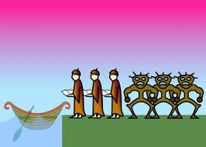
Classic AI search problems Missionaries and cannibals Problem
Three missionaries and three cannibals are on the left bank of a river.
There is one canoe which can hold one or two people.
Find a way to get everyone to the right bank, without ever leaving a group of missionaries in one place outnumbered by cannibals in that place.

Slide 27
Thank you

